Slide 1
Global Carbon Flux Analysis (2010-2022)
Programming for Data Science — Freeform Programming Exercise
Dataset: NASA Carbon Monitoring System Carbon Flux Total L4 V3 (CMSFluxTotal)
This presentation provides an overview of the CMSFluxTotal dataset and explains why
analysing global carbon flux is important for understanding environmental and
climate processes. It includes summary statistics, multiple visualisations
covering temporal, spatial, and statistical analyses, and a
discussion of the insights gained from the data.
The presentation also highlights the
coding challenges encountered
during the project and
how they were
addressed.
Notes:
Introduce the project and dataset.
State that the analysis explores global carbon flux patterns using Python.
Outline what the presentation covers.
Emphasise the mix of scientific analysis and programming.

Slide 2
Dataset Description & Why Carbon Flux Matters
The dataset used in this project is the NASA Carbon Monitoring System Carbon Flux Total L4 V3 (CMSFluxTotal) dataset. It provides monthly global carbon flux estimates from January 2010 to December 2022. The dataset includes latitude, longitude, time, and the variable total_post, representing carbon exchange between the Earth’s surface and the atmosphere. It is stored in NetCDF format and accessed via NASA Earthdata. Due to its large size, the dataset was loaded manually using a relative path. The analysis uses xarray for multidimensional data handling and pandas for tabular operations.
Carbon flux represents the movement of carbon between the land surface and the atmosphere. Understanding carbon flux is essential for studying climate change, vegetation cycles, and atmospheric carbon balance. Seasonal and spatial patterns reveal ecological processes such as photosynthesis, respiration, and land‑use changes. Analysing this dataset helps identify global carbon sources and sinks, understand environmental variability, and support climate modelling efforts.
Notes:
Explain that the dataset is scientific‑grade and multidimensional.
Mention that it captures carbon exchange across land, ocean, and atmosphere.

Slide 3
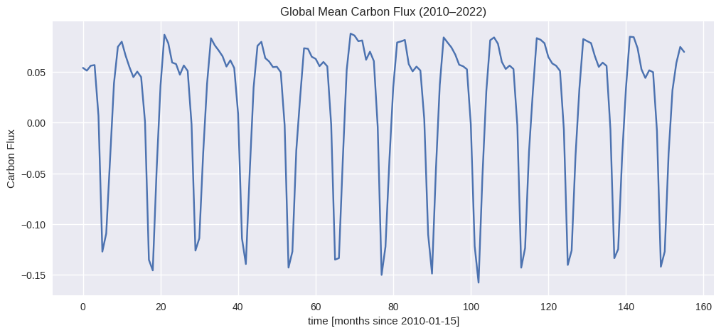
Global Mean Carbon Flux Trend (2010–2022)
The global mean carbon flux was calculated by averaging flux values across all latitudes and longitudes. The resulting time‑series plot shows clear seasonal fluctuations throughout the 13‑year period. Although the flux varies month‑to‑month, there is no extreme long‑term upward or downward trend. The seasonal pattern reflects natural cycles of vegetation growth and decay, particularly in the Northern Hemisphere, where most terrestrial biomass is located.
Notes:
Strong seasonal fluctuations dominate the long‑term trend.
No major long‑term drift is visible in the global mean.

Slide 4
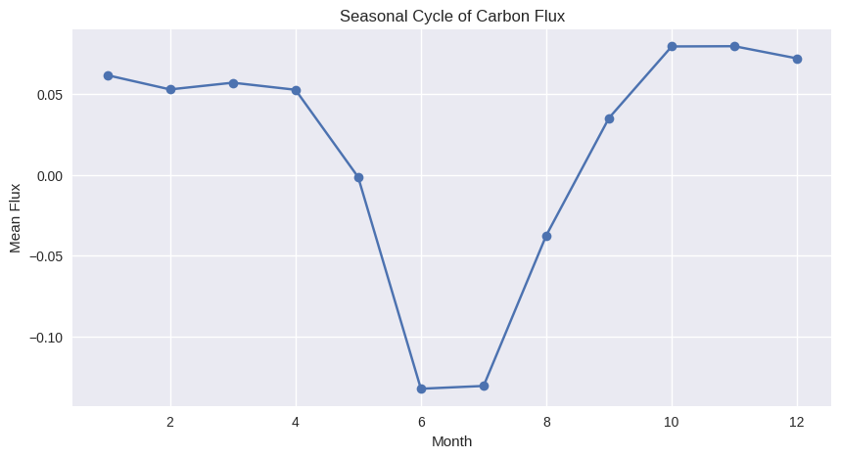
Seasonal Cycle of Carbon Flux
To analyse seasonal behaviour, the time coordinate was converted to date-time format. The average flux for each month was then computed. The seasonal cycle plot shows a clear annual pattern, with flux values peaking during mid‑year months due to increased vegetation activity. This pattern reflects global photosynthesis and respiration cycles, which are strongest during the growing season.
Notes:
Seasonal cycle shows predictable annual behaviour.
Peaks correspond to periods of high vegetation activity.

Slide 5
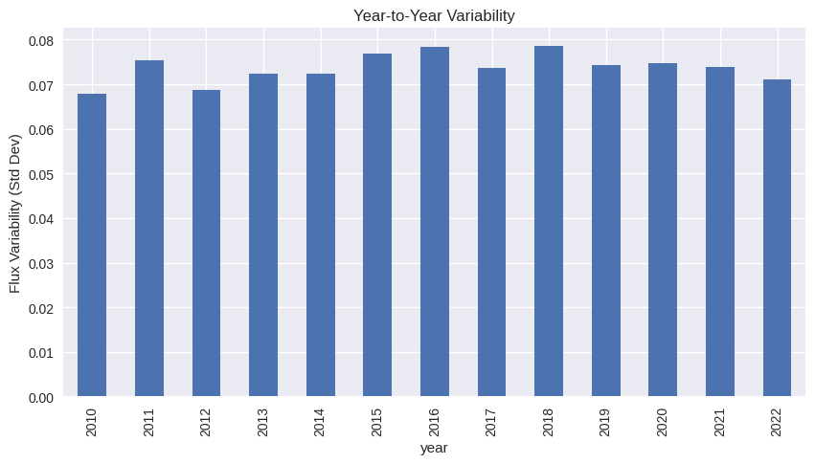
Year‑to‑Year Variability
Year‑to‑year variability was calculated using the standard deviation of monthly flux values for each year. The bar chart shows that some years exhibit higher variability than others, indicating environmental fluctuations such as droughts, heatwaves, or unusual vegetation responses. This metric helps identify years with unstable carbon exchange patterns and highlights the influence of climate variability.
Notes:
Variability differs across years, reflecting environmental changes.
High‑variability years may correspond to climate anomalies.

Slide 6
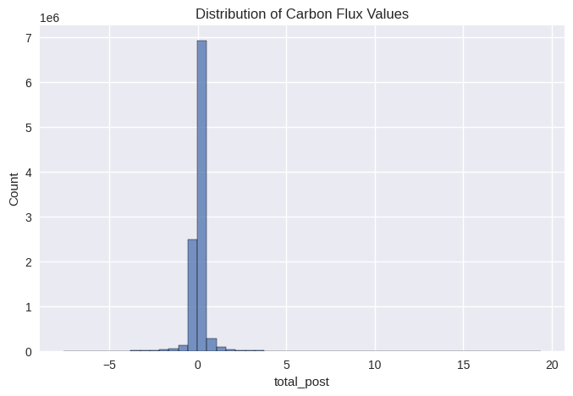
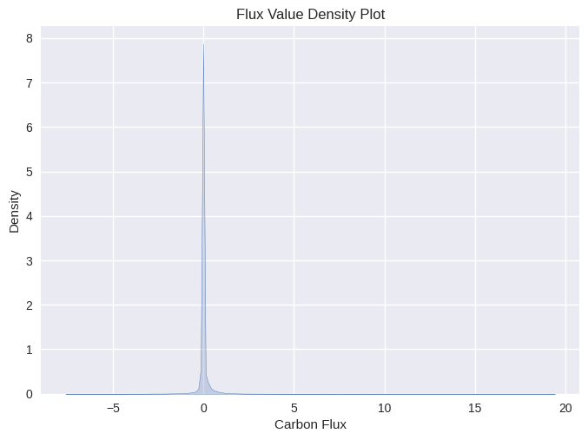
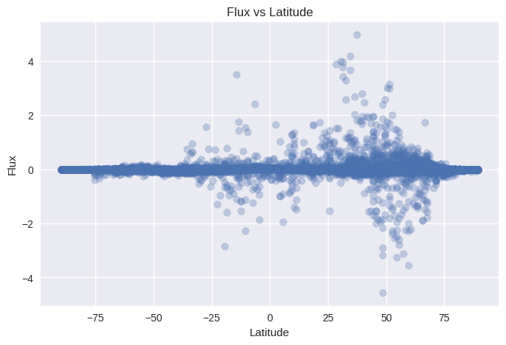
Distribution, Histogram, KDE, and Scatter Plot
A histogram of flux values shows a skewed distribution with a long tail, indicating the presence of extreme flux values. The KDE plot provides a smooth density estimate, confirming the non‑normal distribution. A scatter plot of latitude versus flux reveals that flux values vary significantly by latitude, with noticeable clustering in certain regions. These visualisations highlight the need for anomaly detection and justify the use of Z‑scores to identify extreme values.
Notes:
Flux distribution is skewed with extreme values.
Latitude influences flux behaviour, showing clear spatial patterns.

Slide 7
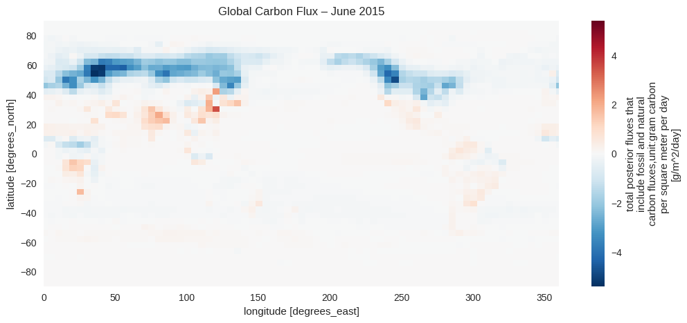
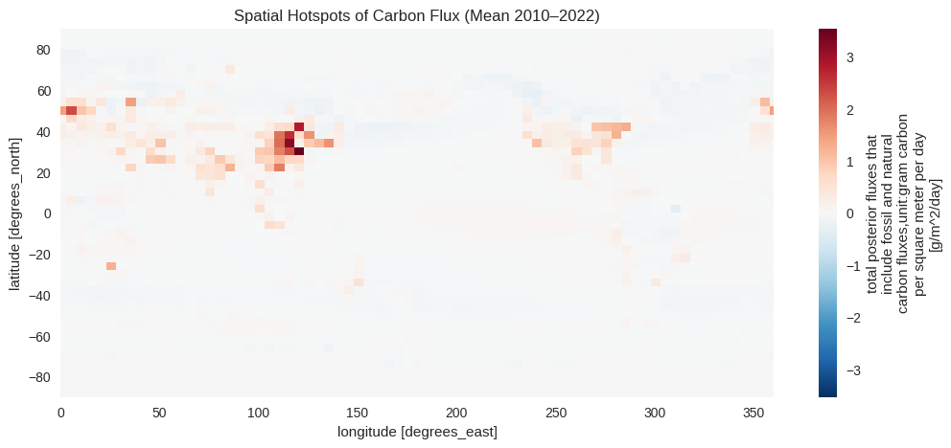
Spatial Maps and Hotspots
A spatial map for June 2015 shows strong regional differences in carbon flux. Tropical regions exhibit high flux due to intense biological activity, while polar regions show lower flux. A time‑averaged hotspot map (2010–2022) highlights persistent high‑flux regions such as the Amazon, Central Africa, and Southeast Asia. These hotspots reflect strong photosynthesis and respiration cycles and indicate regions with intense carbon exchange.
Notes:
Spatial patterns reveal ecological and climatic differences.
Hotspots show regions with consistently high carbon exchange.

Slide 8
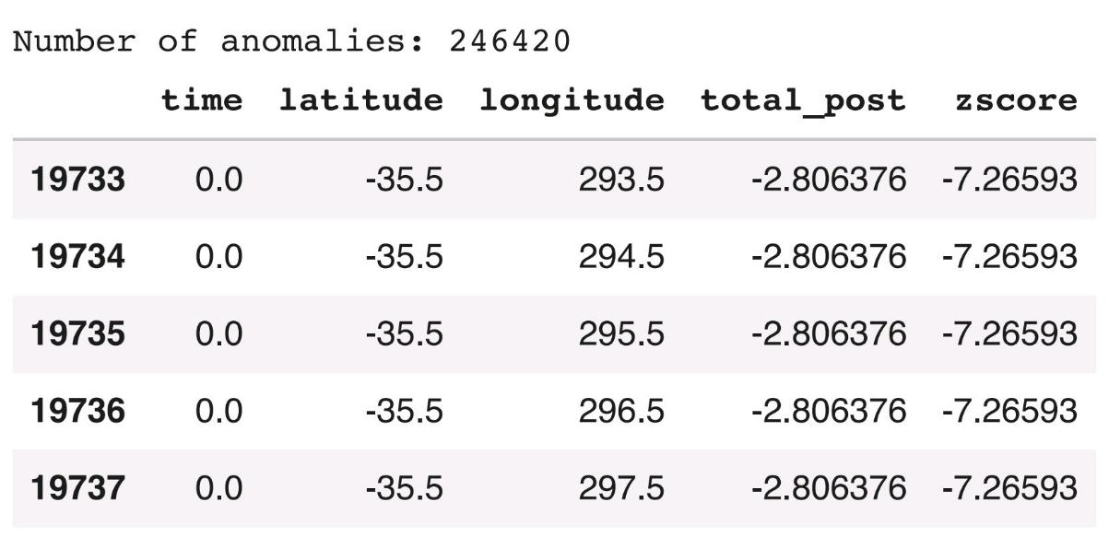
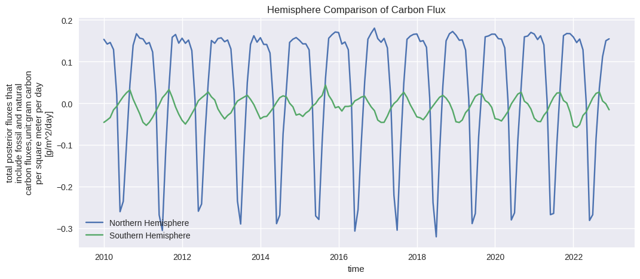
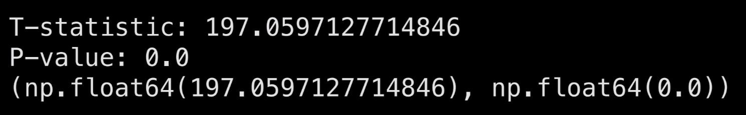
Statistical Analysis & Hemisphere Comparison
Z‑score anomaly detection identified flux values more than three standard deviations from the mean, indicating extreme environmental events. Hemisphere comparison shows clear differences between the Northern and Southern Hemispheres. A t‑test confirms that the difference in mean flux between hemispheres is statistically significant, reflecting differences in vegetation density, climate, and land‑use patterns.
Notes:
Anomalies highlight extreme flux behaviour.
T‑test shows hemispheres differ significantly in mean flux.

Slide 9
Coding Challenges
Several coding challenges were encountered during the analysis. The time coordinate in the dataset was stored as numeric offsets, requiring manual reconstruction of datetime values. The dataset was large, so converting xarray objects to pandas required careful memory management. Scatter plots required sampling to avoid performance issues. Spatial plotting also required correct handling of latitude and longitude dimensions to ensure accurate visualisation. Separating hemispheres required masking using .where() and averaging across dimensions. Ensuring reproducibility required switching from absolute paths to relative paths so the notebook runs on any machine. Code quality was improved by adding comments, removing redundancy, and ensuring each visualisation was meaningfully different.
Notes:
Time decoding and dataset size were major challenges.
Sampling was necessary for efficient visualisation.
Hemisphere masking and reproducibility required careful coding.
Clean code and comments improved clarity and assessment quality.

Slide 10
What I Learned
This project strengthened my ability to work with multidimensional scientific datasets using xarray. I learned how to analyse temporal and spatial patterns in environmental data, build meaningful visualisations, and apply statistical methods such as anomaly detection and t‑tests. I also improved my Python workflow, debugging skills, and understanding of global carbon flux behaviour. Overall, the project enhanced my confidence in handling real‑world environmental datasets.
REFERENCES
(1) NASA Goddard Earth Sciences Data and Information Services Center (GES DISC).
Carbon Monitoring System (CMS) Carbon Flux Total L4 V3 (CMSFluxTotal); NASA Earthdata: Greenbelt, MD.
(2) Hoyer, S.; Hamman, J. xarray: N‑D Labeled Arrays and Datasets in Python. J. Open Res. Softw. 2017, 5 (1), 1–6.
(3) McKinney, W. Data Structures for Statistical Computing in Python. Proc. Python Sci. Conf. 2010, 51–56.
(4) Hunter, J. D. Matplotlib: A 2D Graphics Environment. Comput. Sci. Eng. 2007, 9 (3), 90–95.
(5) Virtanen, P.; et al. SciPy: Fundamental Algorithms for Scientific Computing in Python. Nat. Methods 2020, 17, 261–272.
(6) Waskom, M. Seaborn: Statistical Data Visualization. J. Open Source Softw. 2021, 6 (60), 3021.
Notes:
Gained scientific insight into carbon flux patterns.
Improved technical skills in Python, xarray, and visualisation.
Cite dataset and tools used.
Analysis is based on the dataset.

